Slide 1

Data Communication and Networking (DCAN 202)
Week 3
Kent Institute Australia Pty. Ltd.
ABN 49 003 577 302 CRICOS Code: 00161E RTO Code: 90458 TEQSA Provider Number: PRV12051
Version 2 – 18th December 2015

Slide 2
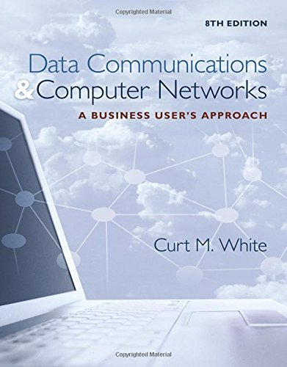
Chapter 3: Conducted and Wireless Media
Data Communications and Computer Networks: A Business User's Approach, Eighth Edition
© 2016. Cengage Learning. All right reserved.

Slide 3
Todays Lecture
Twisted-pair wire
Characteristics, advantages, disadvantages
Differences between Category 1, 2, 3, 4, 5, 5e, 6, and 7
Shielded vs Unshielded twisted pair wire
Coaxial cable & Fiber-Optic cable
Microwave systems
Terrestrial & Microwave
Basics of cellular telephones
Short-range transmission technologies (Bluetooth)

Slide 4
Todays Lecture
Characteristics, advantages, and disadvantages of:
Wireless Application Protocol (WAP),
Broadband wireless systems, and
Various wireless local area network transmission techniques
Media selection criteria of cost, speed, right-of-way, expandability and distance, environment, and security to various media in a particular application

Slide 5
Introduction
The world of computer networks would not exist if there were no medium by which to transfer data
The two major categories of media include:
Conducted media
Wireless media

Slide 6
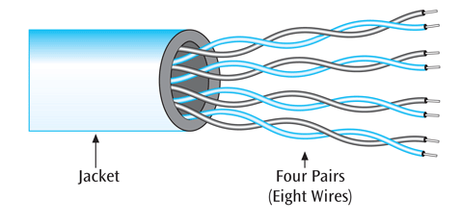
Twisted Pair Wire
One or more pairs of single conductor wires that have been twisted around each other
Twisted pair wire is classified by category.
Currently Category 1 through Category 7
Categories 1, 2 and 4 are nearly obsolete
Twisting the wires helps to eliminate electromagnetic interference between the two wires
Shielding can further help to eliminate interference
Source: Data Communications and Computer Networks: A Business User's Approach, Eighth Edition
© 2016. Cengage Learning. All right reserved.
Example of a four-pair twisted pair wire

Slide 7
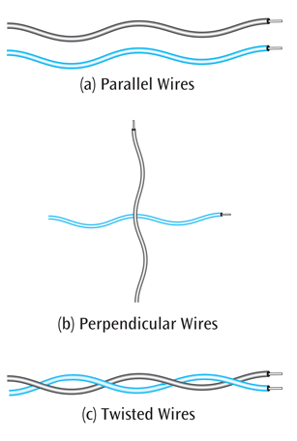
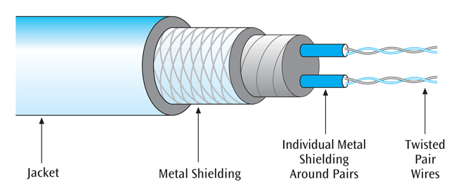
Twisted Pair Wire
Parallel wires - greater chance of crosstalk
Perpendicular wires - lesser chance of crosstalk
Twisted wires - crosstalk reduced because wires keep crossing each other at nearly perpendicular angles
Source: Data Communications and Computer Networks: A Business User's Approach, Eighth Edition
© 2016. Cengage Learning. All right reserved.
Example of shielded twisted pair

Slide 8
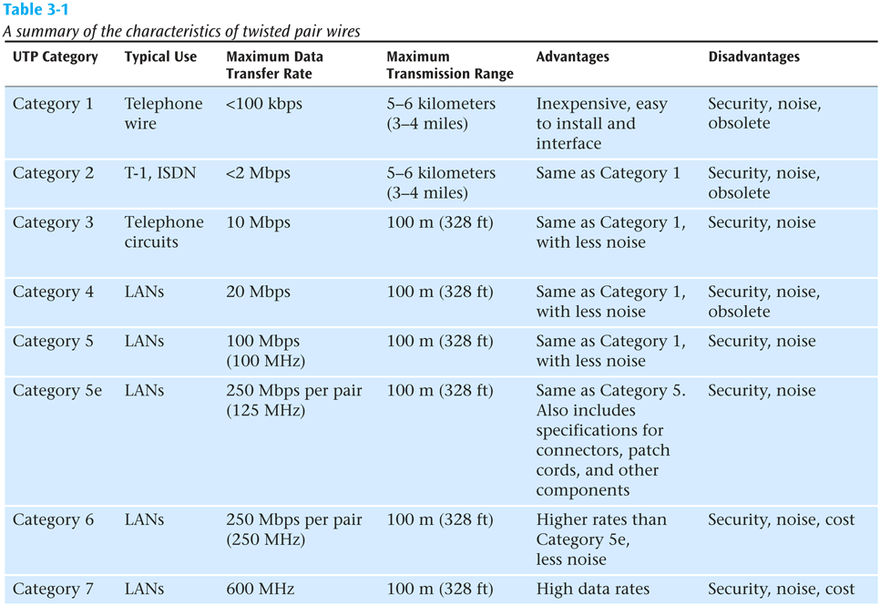
Twisted Pair Wire
Source: Data Communications and Computer Networks: A Business User's Approach, Eighth Edition
© 2016. Cengage Learning. All right reserved.
Summary of characteristics of twisted pair wires

Slide 9
Twister Pair - Summary
Most common form of wire
Relatively inexpensive
Easy to install
Carries high data rates (but not the highest)
Can suffer from electromagnetic noise
Can be easily wire-tapped
Comes in shielded and unshielded forms

Slide 10
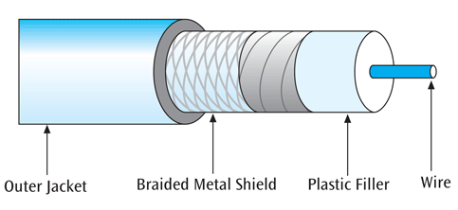
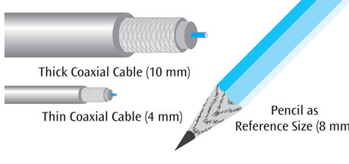
Coaxial Cable
A single wire wrapped in a foam insulation surrounded by a braided metal shield, then covered in a plastic jacket.
Cable comes in various thicknesses
Baseband coaxial technology uses digital signalling in which the cable carries only one channel of digital data
Broadband coaxial technology transmits analog signals and is capable of supporting multiple channels
Example of coaxial cable showing metal braid
Source: Data Communications and Computer Networks: A Business User's Approach, Eighth Edition
© 2016. Cengage Learning. All right reserved.
Example of thick and thin coaxial cables

Slide 11
Coaxial Cable - Summary
A single wire surrounded by a braided shield
Because of shielding, can carry a wide bandwidth of frequencies
Thus is good with applications such as cable television
Not as easy to install as twisted pair
More expensive than twisted pair

Slide 12
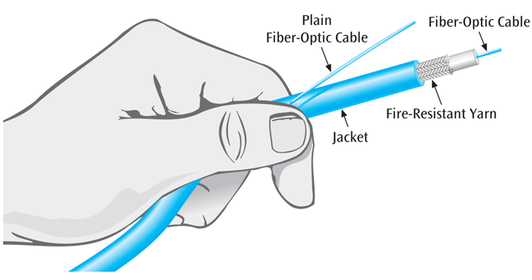
Fiber-Optic Cable
A thin glass cable approximately a little thicker than a human hair surrounded by a plastic coating and packaged into an insulated cable
A photo diode or laser generates pulses of light which travel down the fiber optic cable and are received by a photo receptor
Source: Data Communications and Computer Networks: A Business User's Approach, Eighth Edition
© 2016. Cengage Learning. All right reserved.
Plain fibre-optic cable Vs Fibre-optic cable in an insulated jacket

Slide 13
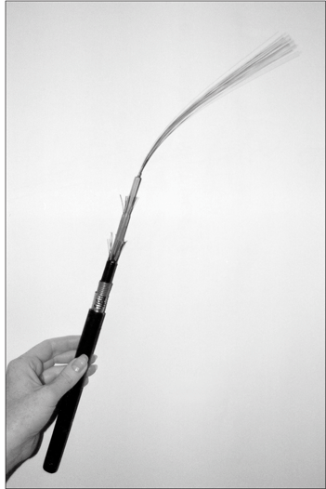
Fiber-Optic Cable (cont..)
Fiber-optic cable is capable of supporting millions of bits per second for 1000s of meters
Thick cable (62.5/125 microns) causes more ray collisions, so you have to transmit slower. This is step index multimode fiber. Typically use LED for light source, shorter distance transmissions
Thin cable (8.3/125 microns) – very little reflection, fast transmission, typically uses a laser, longer transmission distances; known as single mode fiber
Source: Data Communications and Computer Networks: A Business User's Approach, Eighth Edition
© 2016. Cengage Learning. All right reserved.
A fiber-optic cable with multiple strands of fiber

Slide 14
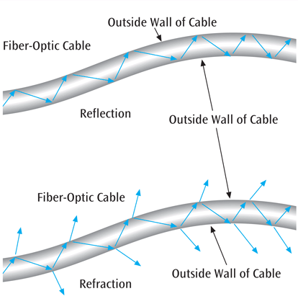
Fiber-Optic Cable (cont..)
Fiber-optic cable is susceptible to reflection (where the light source bounces around inside the cable) and refraction (where the light source passes out of the core and into the surrounding cladding)
Thus, fiber-optic cable is not perfect either. Noise is still a potential problem
Source: Data Communications and Computer Networks: A Business User's Approach, Eighth Edition
© 2016. Cengage Learning. All right reserved.
A simple demonstration of reflection and refraction in a fiber-optic cable

Slide 15
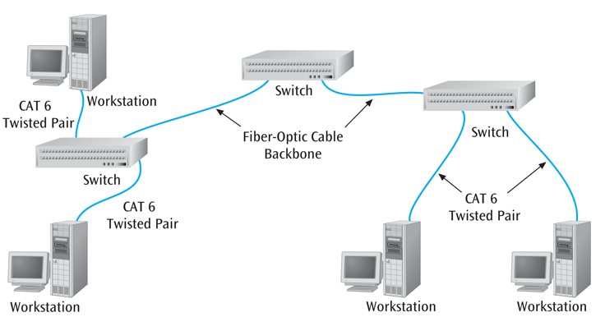
Fiber-Optic Cable (cont..)
Source: Data Communications and Computer Networks: A Business User's Approach, Eighth Edition
© 2016. Cengage Learning. All right reserved.
A fiber-optic backbone with Category 6 twisted pair running to the workstations

Slide 16
Fiber-Optic Cable - Summary
Fiber optic cable can carry the highest data rate for the longest distances
Initial cost-wise, more expensive than twisted pair, but less than coaxial cable
But when you consider the superiority of fiber, initial costs outweighed by capacities
Need to fibers for a round-trip connection
Not affected by electromagnetic noise and cannot be easily wiretapped, but still noise

Slide 17
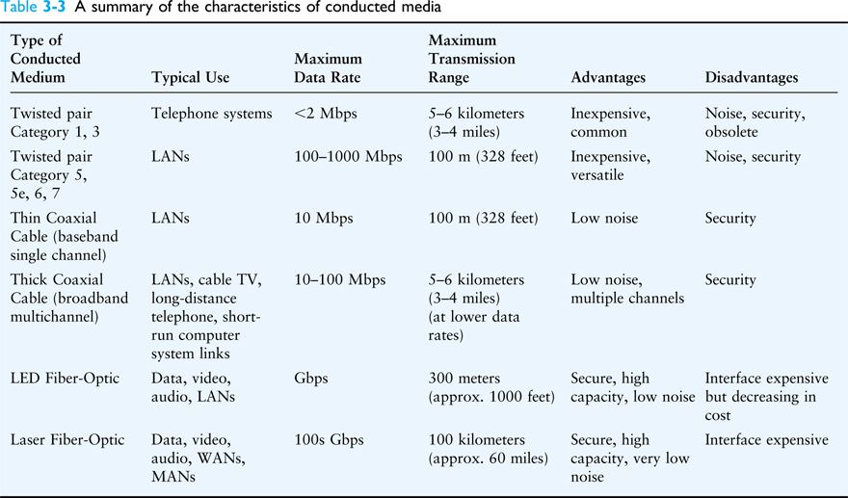
Conducted Media
Source: Data Communications and Computer Networks: A Business User's Approach, Eighth Edition
© 2016. Cengage Learning. All right reserved.
A summary of the characteristics of conducted media

Slide 18
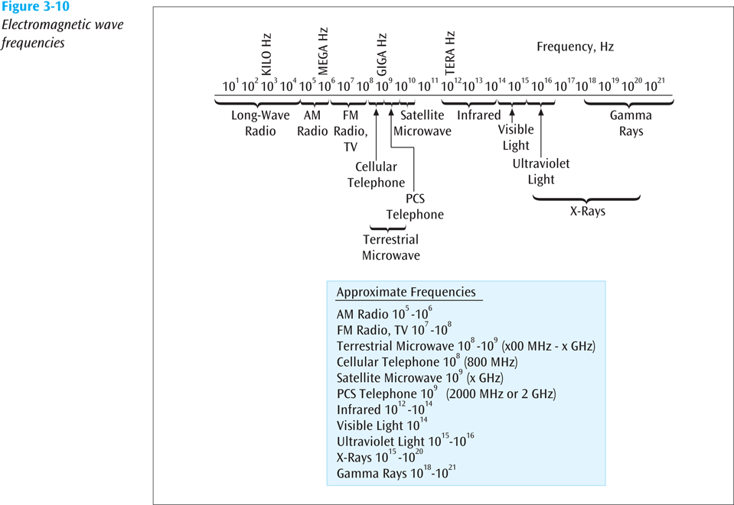
Wireless Media
Radio, satellite transmissions, and infrared light are all different forms of electromagnetic waves that are used to transmit data
Technically speaking – in wireless transmissions, space is the medium
Note in the following figure how each source occupies a different set of frequencies
Source: Data Communications and Computer Networks: A Business User's Approach, Eighth Edition
© 2016. Cengage Learning. All right reserved.
Electromagnetic Wave Frequencies

Slide 19
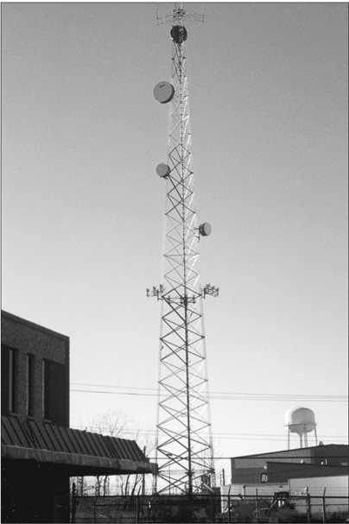
Terrestrial Microwave Transmission
Land-based, line-of-sight transmission
Approximately 20-30 miles between towers
Transmits data at hundreds of millions of bits per second
Signals will not pass through solid objects
Popular with telephone companies and business to business transmissions
Source: Data Communications and Computer Networks: A Business User's Approach, Eighth Edition
© 2016. Cengage Learning. All right reserved.
A typical microwave tower and antenna

Slide 20
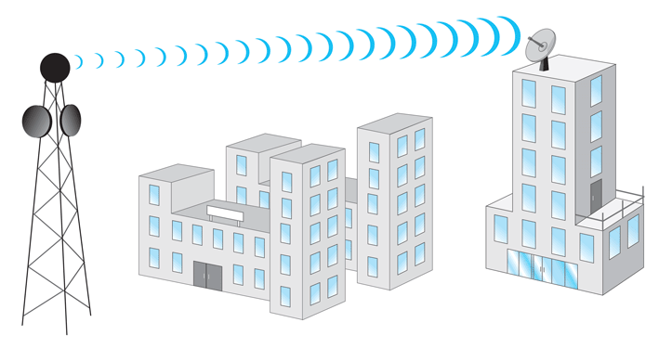
Terrestrial Microwave Transmission (continued)
Source: Data Communications and Computer Networks: A Business User's Approach, Eighth Edition
© 2016. Cengage Learning. All right reserved.
A microwave antenna on top of a free-standing tower transmitting to another antenna on the top of a building.

Slide 21
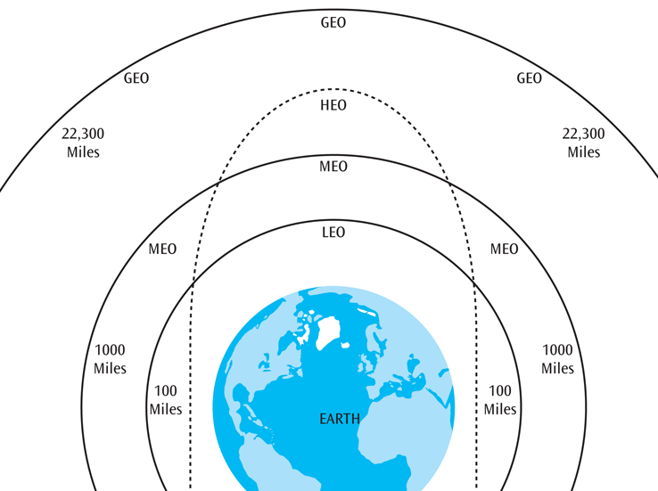
Satellite Microwave Transmission
Similar to terrestrial microwave except the signal travels from a ground station on earth to a satellite and back to another ground station
Can also transmit signals from one satellite to another
Satellites can be classified by how far out into orbit each one is (LEO, MEO, GEO, and HEO)
Source: Data Communications and Computer Networks: A Business User's Approach, Eighth Edition
© 2016. Cengage Learning. All right reserved.
Earth and the four Earth orbits: LEO, MEO, GEO, and HEO

Slide 22
Satellite Microwave Transmission (continued)
LEO (Low-Earth-Orbit) – 100 to 1000 miles out
Used for wireless e-mail, special mobile telephones, pagers, spying, videoconferencing
MEO (Middle-Earth-Orbit) – 1000 to 22,300 miles
Used for GPS (global positioning systems) and government
GEO (Geosynchronous-Earth-Orbit) – 22,300 miles
Always over the same position on earth (and always over the equator)
Used for weather, television, government operations
HEO (Highly Elliptical Earth orbit) – satellite follows an elliptical orbit
Used by the military for spying and by scientific organizations for photographing celestial bodies

Slide 23
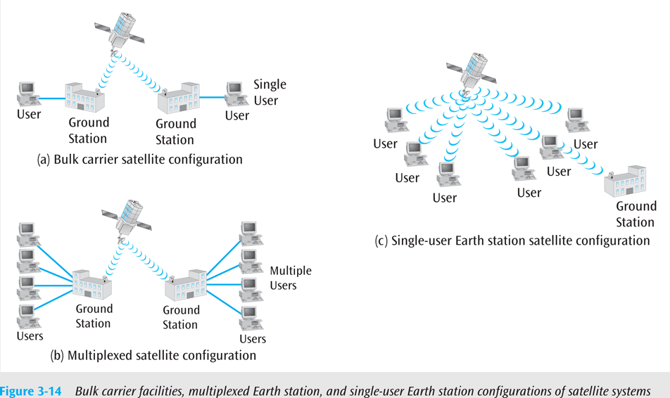
Satellite Microwave Transmission (continued)
Satellite microwave can also be classified by its configuration
Bulk carrier configuration
Multiplexed configuration
Single-user earth station configuration (e.g., VSAT)
Source: Data Communications and Computer Networks: A Business User's Approach, Eighth Edition
© 2016. Cengage Learning. All right reserved.
Bulk carrier facilities, multiplexed Earth station, and single-user Earth station configurations of satellite systems

Slide 24
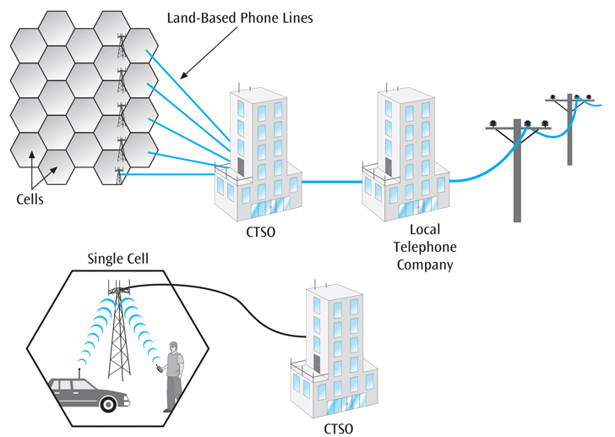
Cellular Telephones
Wireless telephone service, also called mobile telephone, cell phone, and PCS
To support multiple users in a metropolitan area (market), the market is broken into cells
Each cell has its own transmission tower and set of assignable channels
Source: Data Communications and Computer Networks: A Business User's Approach, Eighth Edition
© 2016. Cengage Learning. All right reserved.
One cellular telephone market divided into cells

Slide 25
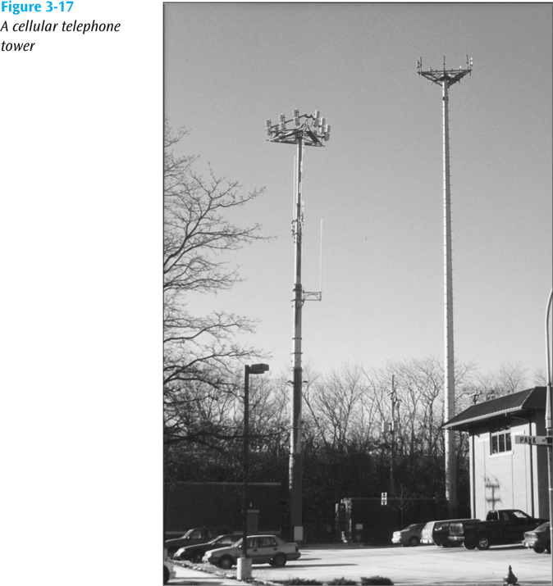
Cellular Telephones (continued)
Placing a call on a cell phone
You enter a phone number on your cell phone and press Send. Your cell phone contacts the nearest cell tower and grabs a set-up channel. Your mobile identification information is exchanged to make sure you are a current subscriber.
If you are current, you are dynamically assigned two channels: one for talking, and one for listening. The telephone call is placed. You talk.
Source: Data Communications and Computer Networks: A Business User's Approach, Eighth Edition
© 2016. Cengage Learning. All right reserved.
A cellular telephone tower

Slide 26
Cellular Telephones (continued)
Receiving a call on a cell phone
Whenever a cell phone is on, it “pings” the nearest cell tower every several seconds, exchanging mobile ID information. This way, the cell phone system knows where each cell phone is.
When someone calls your cell phone number, since the cell phone system knows what cell you are in, the tower “calls” your cell phone.
Source: Data Communications and Computer Networks: A Business User's Approach, Eighth Edition
© 2016. Cengage Learning. All right reserved.
A cellular telephone tower

Slide 27
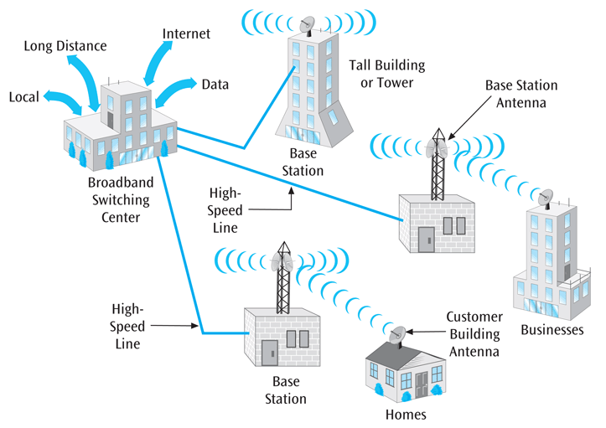
WiMax - Broadband Wireless Systems
Delivers Internet services into homes, businesses and mobile devices
Designed to bypass the local loop telephone line
Transmits voice, data, and video over high frequency radio signals
Maximum range of 20-30 miles and transmission speeds in Mbps
IEEE 802.16 set of standards
Source: Data Communications and Computer Networks: A Business User's Approach, Eighth Edition
© 2016. Cengage Learning. All right reserved.
Broadband wireless configuration in a metropolitan area

Slide 28
Bluetooth
Bluetooth is a specification for short-range, point-to-point or point-to-multipoint voice and data transfer
Bluetooth can transmit through solid, non-metal objects
Its typical link range is from 10 cm to 10 m, but can be extended to 100 m by increasing the power
Bluetooth will enable users to connect to a wide range of computing and telecommunication devices without the need of connecting cables
Typical uses include phones, pagers, modems, LAN access devices, headsets, notebooks, desktop computers, and PDAs

Slide 29
Wireless Local Area Networks (IEEE 802.11)
This technology transmits data between workstations and local area networks using high-speed radio frequencies
Current technologies allow up to 100 Mbps (theoretical) data transfer at distances up to hundreds of feet
Three popular standards: IEEE 802.11b, a, g, n
More on this in Chapter Seven (LANs) (Week 5 Lecture)

Slide 30
Free Space Optics
Free space optics
Uses lasers, or more economically, infrared transmitting devices
Line of sight between buildings
Typically short distances, such as across the street
Newer auto-tracking systems keep lasers aligned when buildings shake from wind and traffic

Slide 31
Ultra-Wideband
Ultra-wideband
UWB not limited to a fixed bandwidth but broadcasts over a wide range of frequencies simultaneously
Many of these frequencies are used by other sources, but UWB uses such low power that it “should not” interfere with these other sources
Can achieve speeds up to 100 Mbps but for small distances such as wireless LANs

Slide 32
Infrared Transmissions
Transmissions that use a focused ray of light in the infrared frequency range
Very common with remote control devices, but can also be used for device-to-device transfers, such as PDA to computer

Slide 33
Near-Field Communications
Very close distances or devices touching
Magnetic induction (such as radio frequency ID) used for transmission of data
Commonly used for data transmission between cellphones (non-Apple devices)

Slide 34
ZigBee
Based upon IEEE 802.15.4 standard
Used for low data transfer rates (20-250 Kbps)
Also uses low power consumption
Ideal for heating, cooling, security, lighting, and smoke and CO detector systems
ZigBee can use a mesh design – a ZigBee-enabled device can both accept and then pass on ZigBee signals

Slide 35
Media Selection Criteria
Cost
Different types of costs
Initial cost – what does a particular type of medium cost to purchase? To install?
Maintenance / support cost
ROI (return on investment) – if one medium is cheaper to purchase and install but is not cost effective, where are the savings?
Speed
Distance and expandability
Environment
Security

Slide 36
Media Selection Criteria
Cost
Speed
Two different forms of speed:
Propagation speed – the time to send the first bit across the medium
This speed depends upon the medium
Airwaves and fiber are speed of light
Copper wire is two thirds the speed of light
Data transfer speed – the time to transmit the rest of the bits in the message
This speed is measured in bits per second
Distance and expandability
Environment
Security

Slide 37
Media Selection Criteria
Cost
Speed
Distance and expandability
Certain media lend themselves more easily to expansion
Don’t forget right-of-way issue for conducted media and line-of-sight for certain wireless media
Environment
Security

Slide 38
Media Selection Criteria
Cost
Speed
Distance and expandability
Environment
Many types of environments are hazardous to certain media
Electromagnetic noise
Scintillation and movement
Extreme environmental conditions
Security

Slide 39
Media Selection Criteria
Cost
Speed
Distance and expandability
Environment
Security
If data must be secure during transmission, it is important that the medium not be easy to tap
Make the wire impervious to electromagnetic wiretapping
Encrypt the signal going over the medium

Slide 40
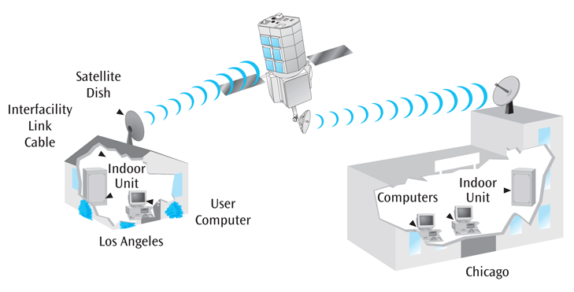
Wireless Media In Action: Three Examples
First example – you wish to connect two computers in your home to Internet, and want both computers to share a printer
Can purchase wireless network interface cards
May consider using Bluetooth devices
Second example – company wants to transmit data between two locations, Chicago and Los Angeles
Company considering two-way data communications service offered through VSAT satellite system
Source: Data Communications and Computer Networks: A Business User's Approach, Eighth Edition
© 2016. Cengage Learning. All right reserved.
VSAT satellite solution for DataMining Corporation

Slide 41
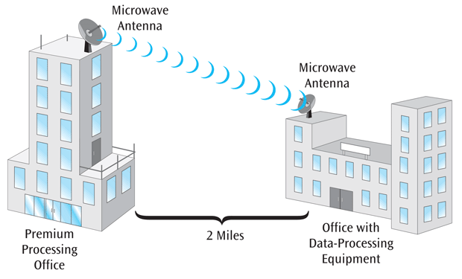
Wireless Media In Action: Three Examples (continued)
Third example – second company wishes to transmit data between offices two miles apart
Considering terrestrial microwave system
Source: Data Communications and Computer Networks: A Business User's Approach, Eighth Edition
© 2016. Cengage Learning. All right reserved.
Microwave communication between American Insurance’s corporate buildings

Slide 42
Summary
All data communication media can be divided into two basic categories: (1) physical or conducted media, and (2) radiated or wireless media, such as satellite systems
The three types of conducted media are twisted pair, coaxial cable, and fiber-optic cable
Twisted pair and coaxial cable are both metal wires and are subject to electromagnetic interference
Fiber-optic cable is a glass wire and is impervious to electromagnetic interference
Experiences a lower noise level
Has best transmission speeds and long-distance performance of all conducted media

Slide 43
Summary (continued)
Several basic groups of wireless media exist: terrestrial microwave transmissions, satellite transmissions, cellular telephone systems, infrared transmissions, WiMAX, Bluetooth, Wi-Fi, free space optics, ultra-wideband, near-field communications, and ZigBee
Each of the wireless technologies is designed for specific applications
When trying to select particular medium for an application, it helps to compare the different media using these six criteria: cost, speed, expandability and distance, right-of-way, environment, and security

Slide 44

kent.edu.au Kent Institute Australia Pty. Ltd. ABN 49 003 577 302 ● CRICOS Code: 00161E ● RTO Code: 90458 ● TEQSA Provider Number: PRV12051

